Slide 1

HUATULCO RACE HISTORY
Elite Analysis · Past 8 Years · May 2026
USA Triathlon High Performance

Slide 2
Race Week Schedule
Huatulco
June 12 – 14, 2026 • Plaza Santa Cruz Huatulco, Mexico
Friday • June 12
Saturday • June 13
Sunday • June 14
Familiarization Day
Briefing & Packet Pickup
RACE DAY
10:00 | Bike familiarization — 3 laps from Bahía Santa Cruz
10:30 | Run familiarization
11:00 – 11:45 | Swim familiarization — Santa Cruz
16:00 – 16:30 | ★ Mandatory Elite athlete meeting — Hotel Biniguenda
16:30 – 17:00 | Packet pickup — Hotel Biniguenda
05:30 | Elite Female lounge opens
06:30 | ★ ELITE FEMALE START
07:45 | Elite Male lounge opens
08:30 | ★ ELITE MALE START
10:00 | Awards ceremony
Times local to Huatulco (CST, UTC-6)

Slide 3
Key Course Differentiators
Huatulco
HUATULCO
COURSE AT A GLANCE
Set around Bahía Santa Cruz on Mexico’s Pacific coast, Huatulco is a hot, humid sprint-distance World Cup. The swim is usually non-wetsuit in very warm water; the bike includes a short climb and corresponding descent. The run is also exposed enough that heat management becomes a major performance limiter. This race often stays close deep into the run, but hilly run, and heat has led to a high DNF/LAP/DNS history. Heat prep leading into and on race day are critical for performance.
Swim:
750 m
Bike:
20.0 km
Run:
5.0 km
Format:
Sprint Triathlon
Bike Laps:
4
COURSE FEATURES
Run Laps:
2
Heat and humidity are the defining environmental factors. Women start earlier at 06:30, but historical race conditions still show warm air, very warm water, and frequent high humidity.
QUICK LINKS
Current Race Info:
The swim is a single 750 m loop from Santa Cruz with warm water that has historically sat around 29–32°C when recorded, making wetsuits extremely unlikely.
Race Info | 2026 World Triathlon Cup Huatulco
Last Year's Results:
The bike is four laps of a 5 km circuit and has a brief climb. The only true breakaway occurred in 2025.
Results | 2025 World Triathlon Cup Huatulco
The run is two laps and includes enough elevation to slow 5 km times significantly The fastest time in several years was 14:45

Slide 4
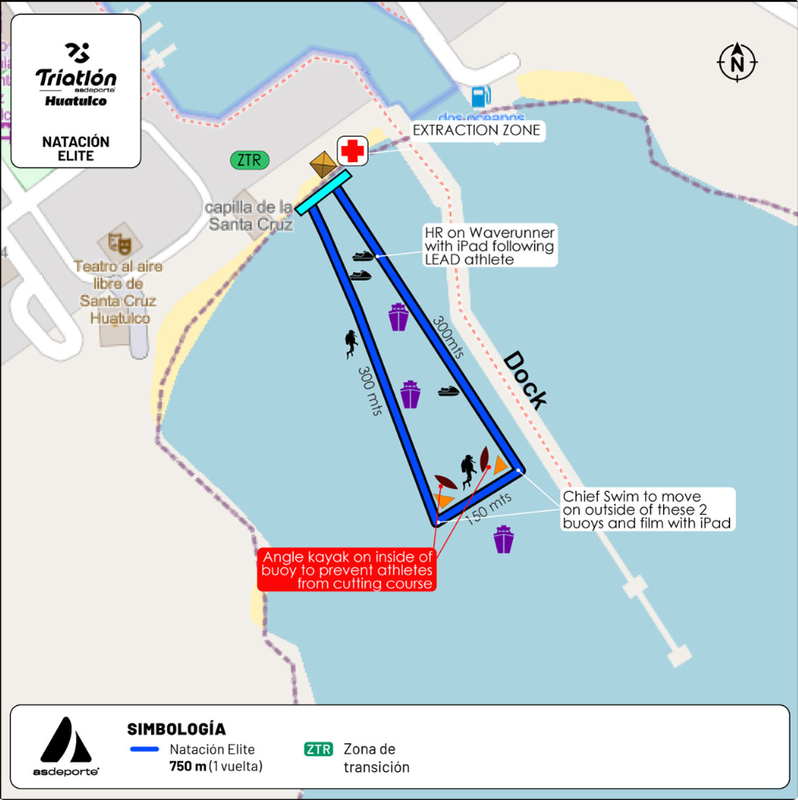
Swim Course Profile
Huatulco
750 m • single lap
Ocean — Bahía de Santa Cruz (protected marina)
Distance
Layout
Start
750 m
U-shape rectangle
Beach start
[Drop swim course map here] Save the organiser map as: ppt files/support/huatulco_swim_course.png It will be embedded automatically on the next run.
Water Temp
Wetsuit
Lap Count
30.5 °C (7-yr avg)
Likely non-wetsuit
1
Tactical Notes
• Single 750 m loop: 300 m east leg, 150 m across south, 300 m west leg, beach exit by transition
• Tight rectangle inside the protected marina. Typically, has minimal chop, current normally low at 06:30 start
• Two turn buoys at the south end with kayak in position here
• Sun rising due east at 06:30. Potential to swim into glare at the start
Source: asdeporte 2026 Elite Swim course map (Natación Elite — Bahía de Santa Cruz)

Slide 5
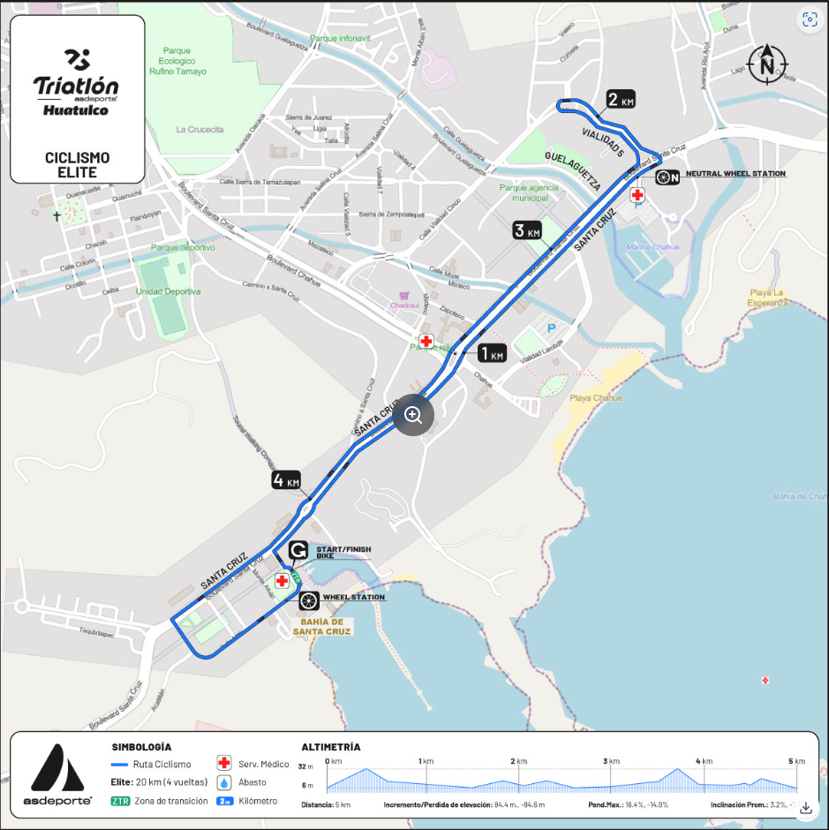
Bike Course Profile
Huatulco
20 km • 4 × 5 km loops
Closed urban circuit (Bahía de Santa Cruz → Vialidad 5 → return)
[Drop course map here] Save the organiser course map as: ppt files/support/huatulco_bike_course.png It will be embedded automatically on the next run.
Elevation / Lap
Total Climb
Avg Grade
+84.4 m / 84.6 m
~338 m
3.2%
Max Climb Grade
Max Descent
Loops
+16.4%
-14.9%
4 × 5 km
Tactical Implications
• Out-and-back along Blvd Santa Cruz with a tight technical hairpin at the neutral wheel station
Source: asdeporte 2026 Elite Cycling course map
• Single sustained climb up Vialidad 5 is short but punchy (max 16.4%)
• Quick descent back into town center; max -14.9% grade
• Tight start/finish chicane through transition

Slide 6
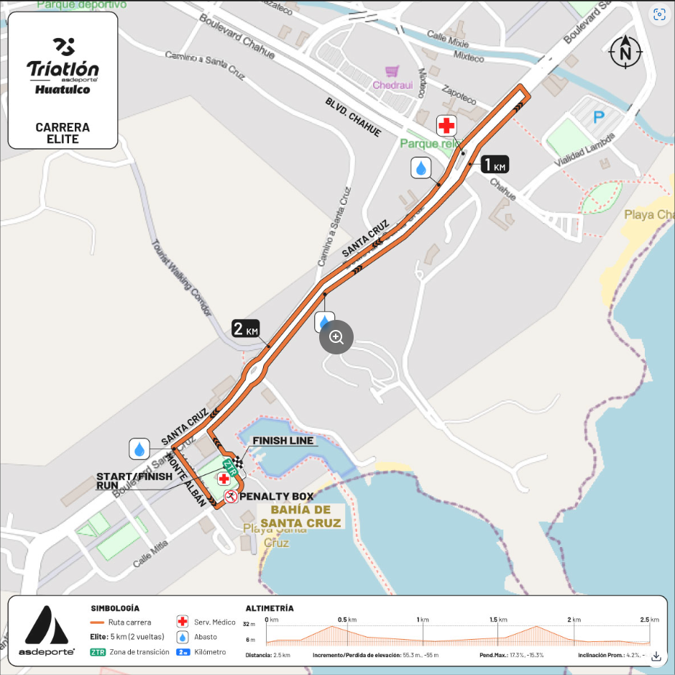
Run Course Profile
Huatulco
5.0 km • 2 × 2.5 km
Paved urban — Blvd Santa Cruz / Camino a Santa Cruz
Distance
Lap Structure
Total Climb
5.0 km
2 × 2.5 km
~111 m
[Drop run course map here] Save the organiser map as: ppt files/support/huatulco_run_course.png It will be embedded automatically on the next run.
Avg Grade
Max ▲ / ▼
Heat Risk
4.2%
+17.3% / -15.3%
HIGH
Tactical Notes
• Hilly 2.5 km out-and-back loop. +55.3 m gain per lap
• Max climb 17.3% on Camino a Santa Cruz; Short steep climb
• Steep -15.3% descent back into Bahía de Santa Cruz
• 08:30 men's start will likely have hot temperatures
• Three turns into the closing 0.5km of the race. Come into sprint with good positioning
Source: asdeporte 2026 Elite Run course map (Carrera Elite — Boulevard Santa Cruz)

Slide 7
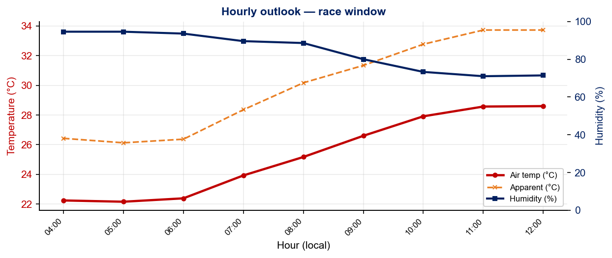
Race-Day Weather Outlook
Huatulco
2026-06-14 • Historical climatology
Female start — 06:30
Temperature
Apparent / Heat
Humidity
23.8 °C
28.3 °C
91%
Wind
UV peak
Heat Stress
3.7 km/h
—
HIGH
Male start — 08:30
Temperature
Apparent / Heat
Humidity
26.6 °C
31.4 °C
81%
Wind
UV peak
Heat Stress
3.8 km/h
—
HIGH
Hydration & Cooling Cues
• Men's race runs 2.8 °C hotter than women's
Data source: Open-Meteo. Forecast will replace climatology once race day is within 16 days.

Slide 8
Environmental Risk Profile
Huatulco
RACE-DAY WEATHER (08:00–11:00 local)
AIR QUALITY (Open-Meteo archive)
Year | Date | Air Temp | Humidity | Wind km/h | Precip mm
2018 | Jun 10 | 29.2 | 72% | 10 | 0.0
2019 | Jun 08 | 28.3 | 77% | 4 | 0.1
2021 | Jun 12 | 26.8 | 82% | 16 | 0.0
2022 | Jun 18 | 28 | 68% | 6 | 0.0
2023 | Jun 17 | 32.8 | 60% | 7 | 0.1
2024 | May 18 | 29.3 | 62% | 7 | 0.0
2025 | Jun 22 | 24 | 96% | 4 | 2.6
Year | PM2.5 | EU AQI | UV Index | Risk
2018 | — | — | — | —
2019 | — | — | — | —
2021 | — | — | — | —
2022 | — | — | — | —
2023 | 7.7 | 21 | 5.3 | Fair
2024 | 4.3 | 20 | 4.3 | Good
2025 | 3.4 | 16 | 4.5 | Good
HEALTH & WATER QUALITY RISK FACTORS
Water Quality: No public Huatulco race-week illness cluster found.
Athlete Health Incidents: No known Huatulco-specific GI illness pattern found.
Water Temperature: Historically very warm when recorded: 2022 men/women ~29–31°C, 2023 ~31.7–31.8°C, 2024 ~30°C, 2025 ~29°C. Expect non-wetsuit and warm-water swim.
Heat / Humidity: High risk. Historical race-window air temperatures range from ~24°C to 35°C, with humidity often above 70% and as high as 96% in 2025. The women start at 06:30, which may offer slightly coolor temperatures.
Weather and AQ data: Open-Meteo historical archive (archive-api.open-meteo.com). EU AQI: Good ≤20, Fair ≤40, Moderate ≤60, Poor ≤80, Very Poor >80.

Slide 9
Who to Watch
ELITE MEN
ELITE WOMEN
Top 3 Ranked on Startlist
Top 3 Ranked on Startlist
Rank | Athlete | Points
15 | Tyler Mislawchuk | 2,943
42 | Aoba Yasumatsu | 2,080
52 | Liam Donnelly | 1,939
Rank | Athlete | Points
24 | Maria Carolina Velasquez Soto | 2,558
25 | Rosa Maria Tapia Vidal | 2,515
49 | Danielle Orie | 1,941
Returning Podium Athletes on Startlist
Returning Podium Athletes on Startlist
2. Alejandro Rodriguez Diez: 2nd Place in 2025 (00:55:07)
1. Maria Carolina Velasquez Soto: 1st Place in 2025 (01:00:08)
3. Kuba Gajda: 3rd Place in 2025 (00:55:11)
3. Elizabeth Bravo: 3rd Place in 2025 (01:00:09)
Rankings = current World Triathlon rankings snapshot;

Slide 10
ELITE MEN

Slide 11
Race Overview — Elite Men
Huatulco
3 KEYS TO SUCCESS
1
Prepare for a non-wetsuit swim. Water temperature around 30C will not only be non-wetsuit but feel very warm. With such warm temps, this has limited the top swimmers from attacking the swim. Expect for at least 15 athletes to exit the water close to each other with the main group not far behind.
2
2025 saw the first true breakaway stick at this course. However, the lead group of 3 was only able to get ~40s for the effort. Likewise in 2023 a much larger breakaway group only put ~60s on the chase. With two long straightaways, expect for the bike to come together if there is a train coming from behind.
3
Heat and elevation on the run drives a slow 5K. The fastest time since 2018 is 14:45 and many years have had no one go under 15:00. Trust in the Park City hill training and make your move against the competition on the second lap here. To achieve a top 10 result, you’ll likely need to be within 35-45 seconds of the winner.

Slide 12
Results Summary — Elite Men
Huatulco
Year | Date | Category | Field | DNF/LAP/DNS | Winner | Winner Time | Air Temp | Water Temp | Swim km | Bike km | Run km
2018 | Jun 10 | World Cup | 66 | 6 | Lopez | 55:32 | 29.2 | — | — | — | —
2019 | Jun 08 | World Cup | 62 | 7 | Mislawchuk | 55:04 | 28.3 | — | — | — | —
2021 | Jun 12 | World Cup | 60 | 11 | Mislawchuk | 53:09 | 26.8 | — | — | — | —
2022 | Jun 18 | World Cup * | 65 | 8 | Grau | 53:47 | 28 | 29 | 0.75 | 20.0 | 5.0
2023 | Jun 17 | World Cup | 64 | 6 | Fajardo | 54:13 | 32.8 | 31.7 | 0.75 | 20.0 | 5.0
2024 | May 18 | World Cup * | 52 | 7 | Murray | 58:07 | 29.3 | 30 | 0.75 | 22.2 | 5.0
2025 | Jun 22 | World Cup * | 49 | 4 | Sagiv | 54:53 | 24 | 29 | 0.75 | 20.0 | 5.0
2024 had longer course and ~3-4 minute longer time
* Course distance changed vs. prior year

Slide 13
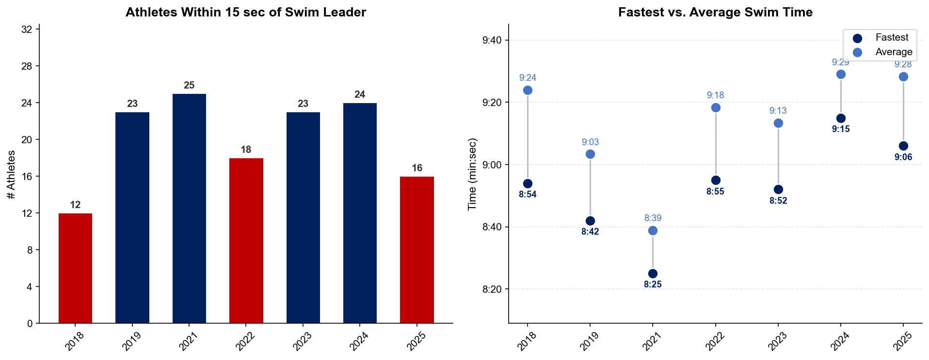
Swim Exit Dynamics — Elite Men
Huatulco
Delta from fastest to the average has been around 15-30 seconds

Slide 14
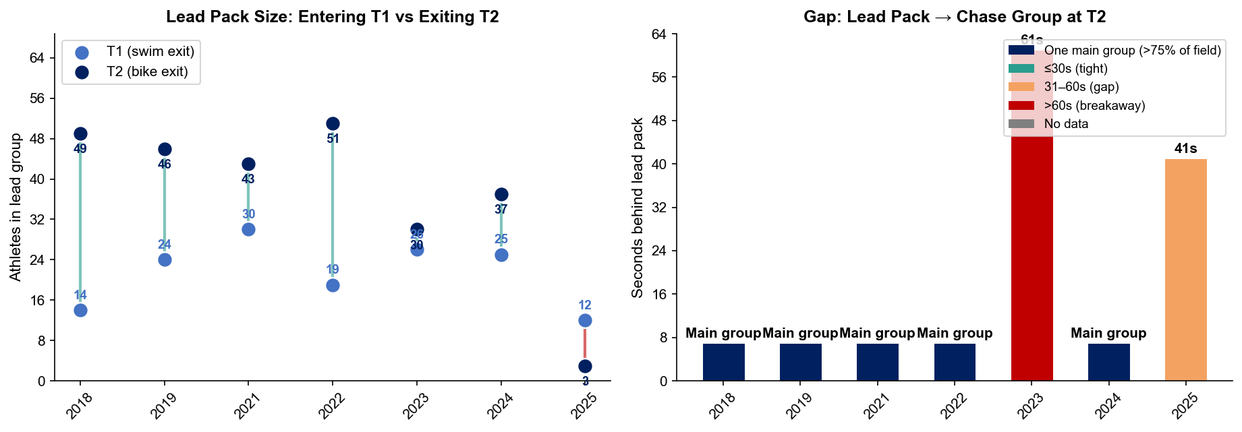
Bike Pack Evolution — Elite Men
Huatulco
Lead pack = athletes within 15 sec of leader. T1 = lead group entering the bike; T2 = lead group exiting the bike.
2025 first true small breakaway (3 athletes)
Year | Lead Size @ T1 | Lead Size @ T2 | Change | Chase Group @ T2 | Chase Gap*
2018 | 14 | 49 | +35 | 1 | 42s
2019 | 24 | 46 | +22 | 7 | 88s
2021 | 30 | 43 | +13 | 1 | 187s
2022 | 19 | 51 | +32 | 1 | 103s
2023 | 26 | 30 | +4 | 22 | 61s
2024 | 25 | 37 | +12 | 1 | 237s
2025 | 12 | 3 | -9 | 31 | 41s
Lead pack = athletes within 15 sec of leader. Chase group = athletes within 15 sec of the first athlete outside the lead pack. * Chase Gap = seconds from the last lead-pack athlete to the first chase-group athlete at T2.

Slide 15
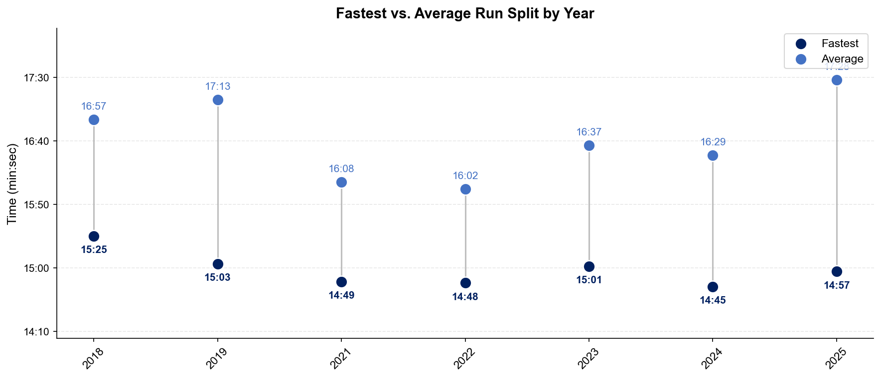
Run Split Analysis — Elite Men
Huatulco
Fastest times consistently just below 15:00. Prepare for a longer 5K than normal

Slide 16
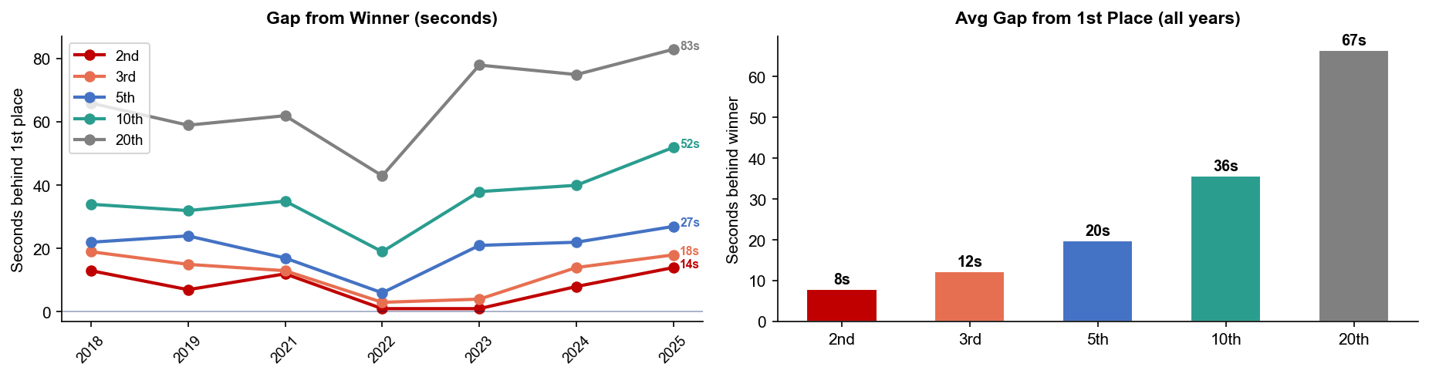
Key Position Times — Elite Men
Huatulco
Decent amount of separation from the winner to top 5. Pace smart and reel in those fading at the end
Year | 1st | 2nd | 3rd | 5th | 10th | 20th
2018 | 55:32 | 55:45 +13s | 55:51 +19s | 55:54 +22s | 56:06 +34s | 56:38 +66s
2019 | 55:04 | 55:11 +7s | 55:19 +15s | 55:28 +24s | 55:36 +32s | 56:03 +59s
2021 | 53:09 | 53:21 +12s | 53:22 +13s | 53:26 +17s | 53:44 +35s | 54:11 +62s
2022 | 53:47 | 53:48 +1s | 53:50 +3s | 53:53 +6s | 54:06 +19s | 54:30 +43s
2023 | 54:13 | 54:14 +1s | 54:17 +4s | 54:34 +21s | 54:51 +38s | 55:31 +78s
2024 | 58:07 | 58:15 +8s | 58:21 +14s | 58:29 +22s | 58:47 +40s | 59:22 +75s
2025 | 54:53 | 55:07 +14s | 55:11 +18s | 55:20 +27s | 55:45 +52s | 56:16 +83s

Slide 17
Race Conditions — Elite Men
Huatulco
Year | Date | Air Temp | Humidity | Wind (km/h) | Precip (mm) | Water Temp | Wetsuit | Conditions
2018 | Jun 10 | 29.2 | 72% | 10 | 0.0 | — | — | —
2019 | Jun 08 | 28.3 | 77% | 4 | 0.1 | — | — | —
2021 | Jun 12 | 26.8 | 82% | 16 | 0.0 | — | — | —
2022 | Jun 18 | 28 | 68% | 6 | 0.0 | 29 | forbidden | —
2023 | Jun 17 | 32.8 | 60% | 7 | 0.1 | 31.7 | — | —
2024 | May 18 | 29.3 | 62% | 7 | 0.0 | 30 | forbidden | —
2025 | Jun 22 | 24 | 96% | 4 | 2.6 | 29 | forbidden | —
Air temp, humidity, wind, and precipitation sourced from Open-Meteo historical archive (race window 08:00–11:00 local) where WT API data is absent. Values marked * are Open-Meteo estimates. Water temp and wetsuit ruling are from the World Triathlon API per program.

Slide 18
ELITE WOMEN

Slide 19
Race Overview — Elite Women
Huatulco
3 KEYS TO SUCCESS
1
Stay attached through the swim and first bike lap. Huatulco does not always reward an all-out swim break, but missing the first organized group can be costly from an energy standpoint. The women’s race has ranged from very small groups at T1 to larger groups by T2, so put yourself close enough to the leaders that you can attach yourself on the bike.
2
While athletes have historically been able to bike to the front group a small to medium breakaway is common in the women’s racing here. If you are able to make a breakaway of ~20 athletes it's not uncommon to put ~2 minutes into the chasers, helping solidify better positioning into the run.
3
The Huatulco 5K is slower than a flat sprint-course run because of heat and elevation. Managing your effort on the short but steep climb amid increasing heat in the morning is key to putting yourself in a strong position over the final 0.5 km. Based on recent gaps, a top-10 result likely requires staying within roughly one minute of the winner, and podium contention has been seen photo finishes in back to back years.

Slide 20
Results Summary — Elite Women
Huatulco
Year | Date | Category | Field | DNF/LAP/DNS | Winner | Winner Time | Air Temp | Water Temp | Swim km | Bike km | Run km
2018 | Jun 10 | World Cup | 41 | 3 | Sodaro | 1:01:14 | 29.2 | — | — | — | —
2019 | Jun 08 | World Cup | 42 | 4 | Rappaport | 1:00:56 | 28.3 | — | — | — | —
2021 | Jun 12 | World Cup | 43 | 5 | Pedersen | 1:00:24 | 26.8 | — | — | — | —
2022 | Jun 18 | World Cup * | 56 | 4 | Koch | 1:00:01 | 29 | 31 | 0.75 | 20.0 | 5.0
2023 | Jun 17 | World Cup | 61 | 7 | Corral | 1:00:31 | 35 | 31.8 | 0.75 | 20.0 | 5.0
2024 | May 18 | World Cup * | 45 | 10 | Pedersen | 1:04:54 | 33.9 | 30 | 0.75 | 22.2 | 5.0
2025 | Jun 22 | World Cup * | 35 | 3 | Soto | 1:00:08 | 24 | 29 | 0.75 | 20.0 | 5.0
* Course distance changed vs. prior year

Slide 21
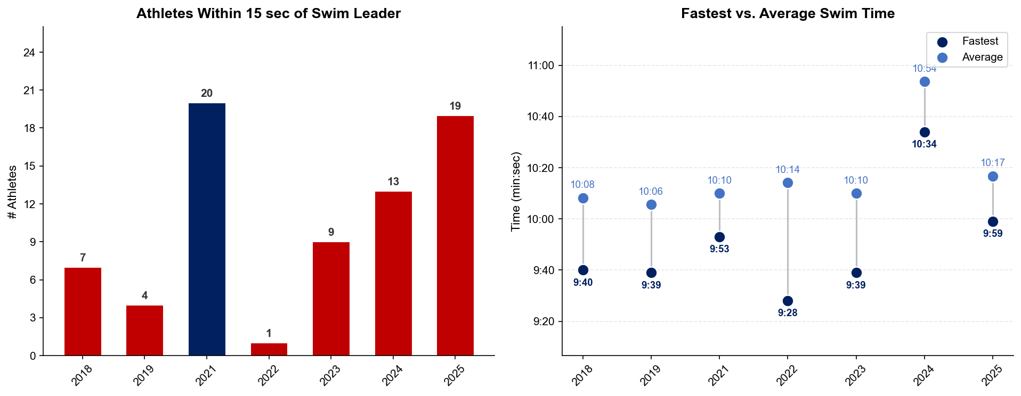
Swim Exit Dynamics — Elite Women
Huatulco

Slide 22
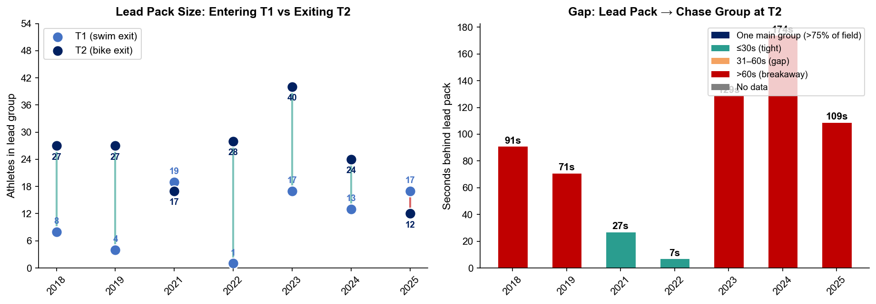
Bike Pack Evolution — Elite Women
Huatulco
Lead pack = athletes within 15 sec of leader. T1 = lead group entering the bike; T2 = lead group exiting the bike.
Year | Lead Size @ T1 | Lead Size @ T2 | Change | Chase Group @ T2 | Chase Gap*
2018 | 8 | 27 | +19 | 5 | 91s
2019 | 4 | 27 | +23 | 7 | 71s
2021 | 19 | 17 | -2 | 1 | 27s
2022 | 1 | 28 | +27 | 1 | 7s
2023 | 17 | 40 | +23 | 1 | 129s
2024 | 13 | 24 | +11 | 5 | 174s
2025 | 17 | 12 | -5 | 14 | 109s
Lead pack = athletes within 15 sec of leader. Chase group = athletes within 15 sec of the first athlete outside the lead pack. * Chase Gap = seconds from the last lead-pack athlete to the first chase-group athlete at T2.

Slide 23
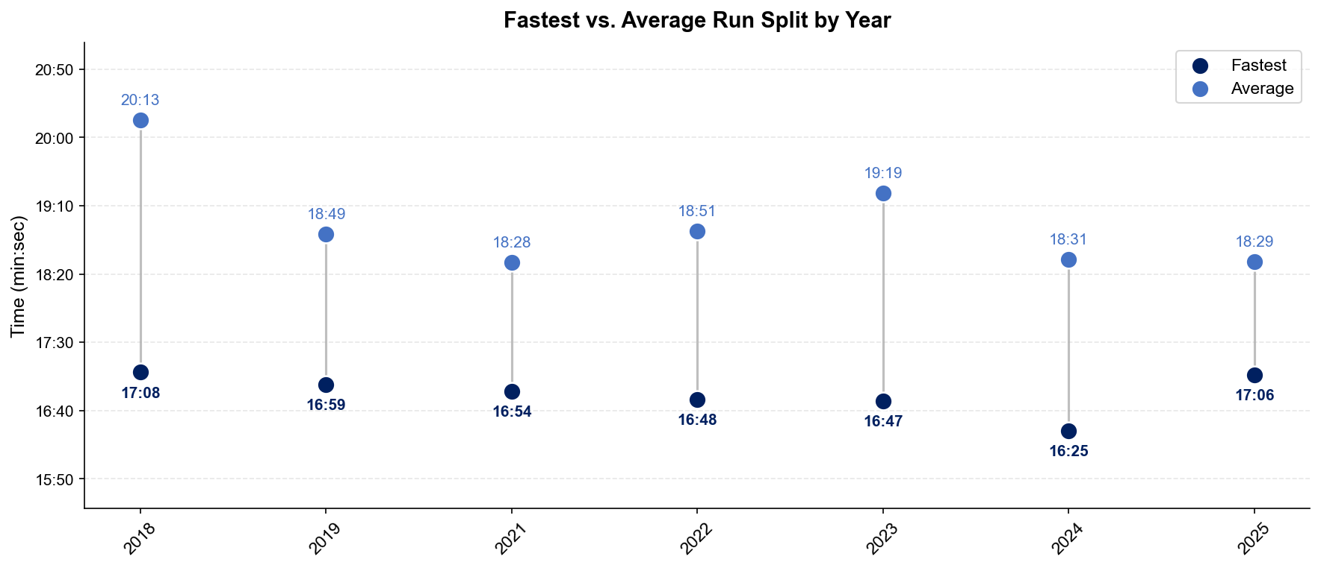
Run Split Analysis — Elite Women
Huatulco

Slide 24
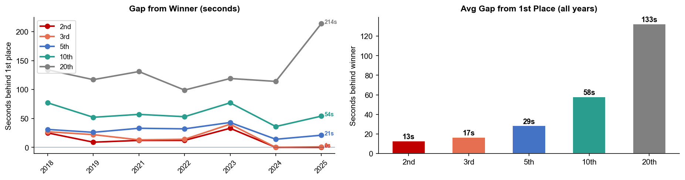
Key Position Times — Elite Women
Huatulco
Year | 1st | 2nd | 3rd | 5th | 10th | 20th
2018 | 1:01:14 | 1:01:39 +25s | 1:01:41 +27s | 1:01:45 +31s | 1:02:31 +77s | 1:03:28 +134s
2019 | 1:00:56 | 1:01:05 +9s | 1:01:18 +22s | 1:01:22 +26s | 1:01:48 +52s | 1:02:53 +117s
2021 | 1:00:24 | 1:00:36 +12s | 1:00:37 +13s | 1:00:57 +33s | 1:01:21 +57s | 1:02:35 +131s
2022 | 1:00:01 | 1:00:13 +12s | 1:00:15 +14s | 1:00:33 +32s | 1:00:54 +53s | 1:01:40 +99s
2023 | 1:00:31 | 1:01:04 +33s | 1:01:11 +40s | 1:01:14 +43s | 1:01:48 +77s | 1:02:30 +119s
2024 | 1:04:54 | 1:04:54 | 1:04:54 | 1:05:08 +14s | 1:05:30 +36s | 1:06:48 +114s
2025 | 1:00:08 | 1:00:08 | 1:00:09 +1s | 1:00:29 +21s | 1:01:02 +54s | 1:03:42 +214s

Slide 25
Race Conditions — Elite Women
Huatulco
Year | Date | Air Temp | Humidity | Wind (km/h) | Precip (mm) | Water Temp | Wetsuit | Conditions
2018 | Jun 10 | 29.2 | 72% | 10 | 0.0 | — | — | —
2019 | Jun 08 | 28.3 | 77% | 4 | 0.1 | — | — | —
2021 | Jun 12 | 26.8 | 82% | 16 | 0.0 | — | — | —
2022 | Jun 18 | 29 | 68% | 6 | 0.0 | 31 | forbidden | —
2023 | Jun 17 | 35 | 60% | 7 | 0.1 | 31.8 | forbidden | —
2024 | May 18 | 33.9 | 62% | 7 | 0.0 | 30 | forbidden | —
2025 | Jun 22 | 24 | 96% | 4 | 2.6 | 29 | forbidden | —
Air temp, humidity, wind, and precipitation sourced from Open-Meteo historical archive (race window 08:00–11:00 local) where WT API data is absent. Values marked * are Open-Meteo estimates. Water temp and wetsuit ruling are from the World Triathlon API per program.

